Slide 1
IP Protocol

Slide 2
IP
Responsible for node to node transmission
Sends data in individual packets
Maximum size of packet is determined by the networks
Fragmented if too large
Unreliable
Packets might be lost, corrupted, duplicated, delivered out of order

Slide 3
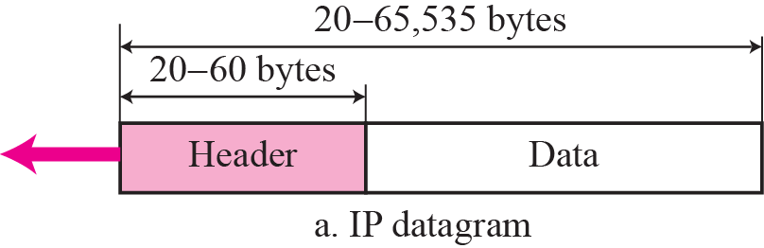
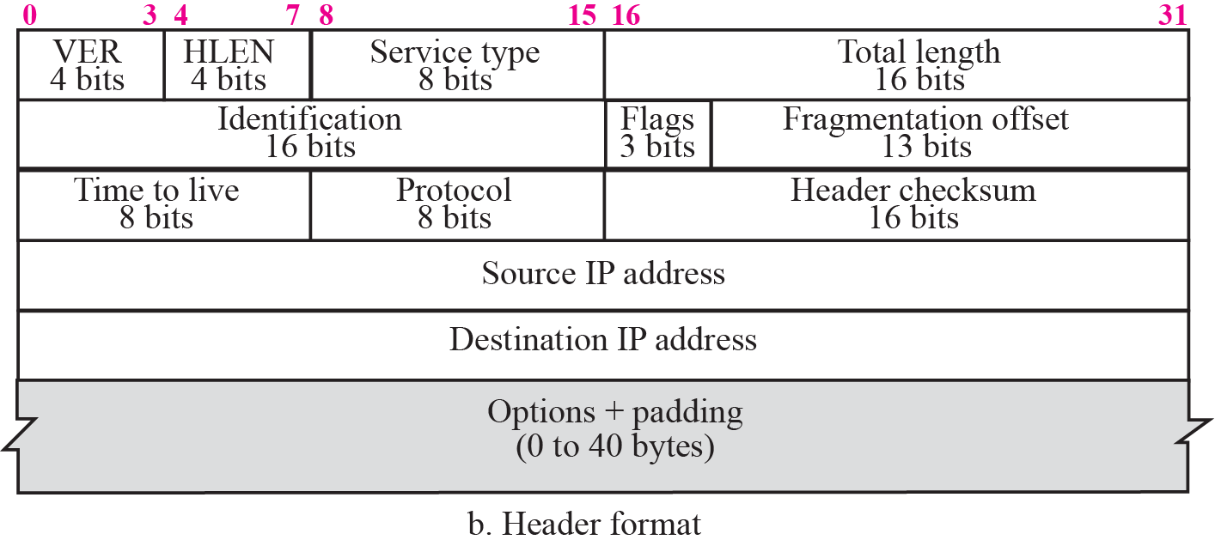
IPv4 Datagram Format

Slide 4
IP Datagram Format (cont.)
Vers (4 bits): version of IP protocol (IPv4=4)
Hlen (4 bits): Header length without options (usual case) = 20 bytes(if Hlen=5) and maximum size 60 bytes (if Hlen = 15).
Type of Service – TOS (8 bits): used for QoS (used for the priority)
Total length (16 bits): length of datagram in bytes, includes header and data.
Time to live – TTL (8bits): specifies how long datagram is allowed to remain in internet
Routers decrement by 1
When TTL = 0 router discards datagram
Prevents infinite loops
Protocol (8 bits): specifies the format of the data area
Identify the protocol being used (TCP or UDP)
Protocol numbers administered by central authority to guarantee agreement, e.g. TCP=6, UDP=17, ICMP=1, IGMP=2 etc

Slide 5
IP Datagram Format (cont.)
Source & destination IP address (32 bits each): contain IP address of sender and intended recipient
Options (variable length): Mainly used to record a route, or timestamps, or specify routing
Header Checksum: Error control

Slide 6
Fragmentation Control
Identification (16-bit) : copied into fragment, allows destination to know which fragments belong to which datagram (identify the datagram)
Fragment Offset (13 bits): specifies the offset in the original datagram of the data being carried in the fragment
Specified in multiple of 8 bytes
Flags (3 bits): control fragmentation
Reserved (0-th bit)
Don’t Fragment – DF (1st bit): D=1-no fragment, D=0-Can fragment
useful for simple (computer bootstrap) application that can’t handle
also used for MTU discovery (see later)
if need to fragment and can’t router discards & sends error to source
More Fragments (least sig bit): tells receiver it has got last fragment M=1 (more fragments are coming) M=0 (last fragment in datagram)
Notes:
Need routing to get message back to origin

Slide 7
IP Fragmentation
MTU = 2000
host
router
router
MTU = 1500
host
MTU = 4000
Every Network has Own Maximum Transmission Unit (MTU)
Largest IP datagram it can carry within its own packet frame
E.g., Ethernet is 1500 bytes
Don’t know MTUs of all intermediate networks in advance
IP Solution
When hit network with small MTU, fragment packets
Might get further fragmentation as proceed farther

Slide 8
Reassembly
Where to do reassembly?
End nodes or at routers?
End nodes -- better
Avoids unnecessary work where large packets are fragmented multiple times
If any fragment missing, delete entire packet
Intermediate nodes -- Dangerous
How much buffer space required at routers?
What if routes in network change?
Multiple paths through network
All fragments only required to go through destination

Slide 9
Fragmentation Related Fields
Length
Length of IP fragment
Identification
To match up with other fragments
Fragment offset
Where this fragment lies in entire IP datagram
Flags
“More fragments” flag
“Don’t fragment” flag

Slide 10
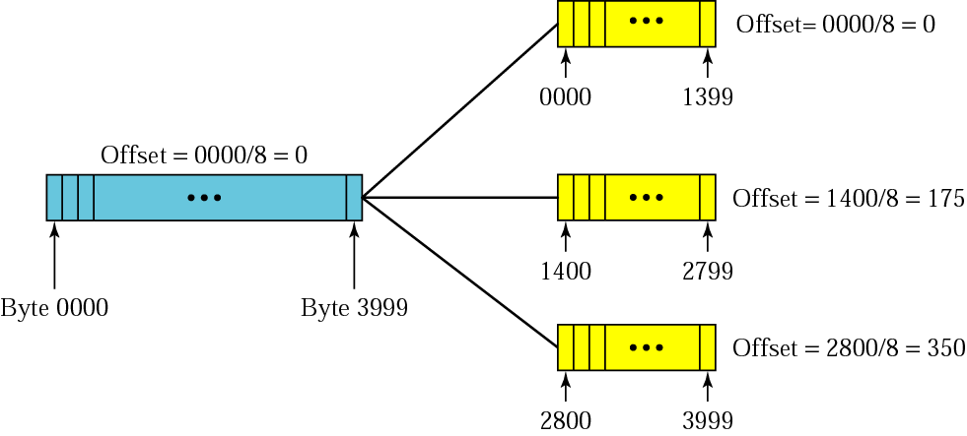
Fragmentation example

Slide 11
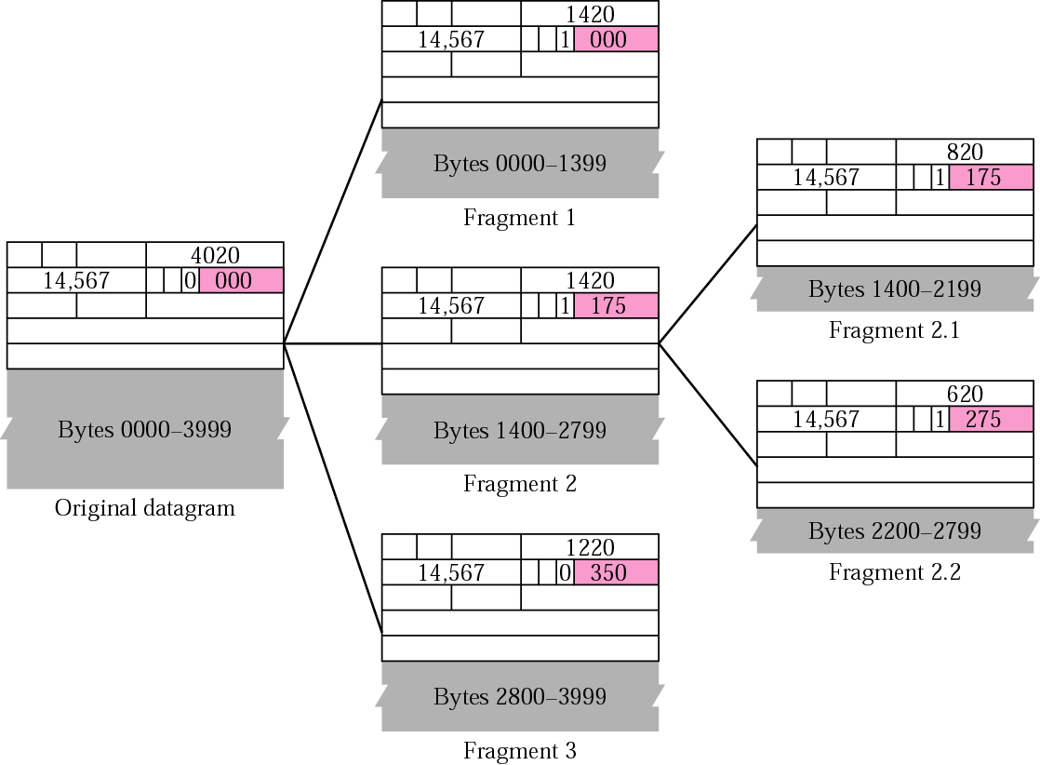
Detailed fragmentation example

Slide 12
Reassembly
The final destination host can reassemble the original datagram from the fragments received (if none of them is lost) using the following strategy:
The first fragment has an offset field value of zero.
Divide the length of the first fragment by 8. The second fragment has an offset value equal to that result.
Divide the total length of the first and second fragment by 8. The third fragment has an offset value equal to that result.
Continue the process. The last fragment has a more bit value of 0

Slide 13
Transparent Fragmentation
Fragmentation is made transparent to subsequent networks, through which the packet pass.
Basic concept:
An oversized packet reaches a router.
Router breaks it up into fragments.
All fragments sent to the same exit router
reassembles the fragments before
forwarding to the next network.

Slide 14
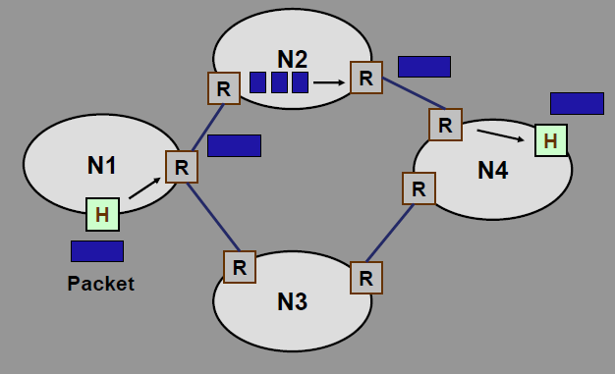
Transparent Fragmentation

Slide 15
Transparent Fragmentation
Drawbacks:
All packets must be routed via the same exit router.
Exit router must know when all the pieces have been received.
Either a “count” field or “end-of-packet” field must be stored in each packet.
Lot of overhead.
A large packet may be fragmented and reassembled repeatedly.

Slide 16
Non-Transparent Fragmentation
Fragmentation is not transparent to subsequent networks.
Basic concept:
Packet fragments are not reassembled at any intermediate router.
Each fragment is treated as an independent packet by the routers.
The fragments are reassembled at the final destination host.

Slide 17
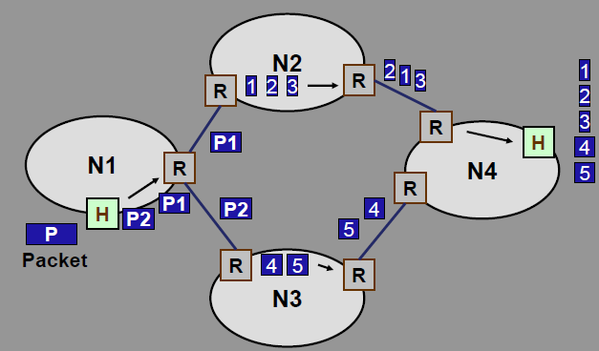
Non-Transparent Fragmentation

Slide 18
Non-Transparent Fragmentation
Advantage:
Multiple exit routers may be used.
Higher throughput.
Drawback:
When a large packet is fragmented, overhead increases.
Each fragment must have a header (Minimum 20 bytes).
IP protocol uses non-transparent fragmentation.

